Slide 1
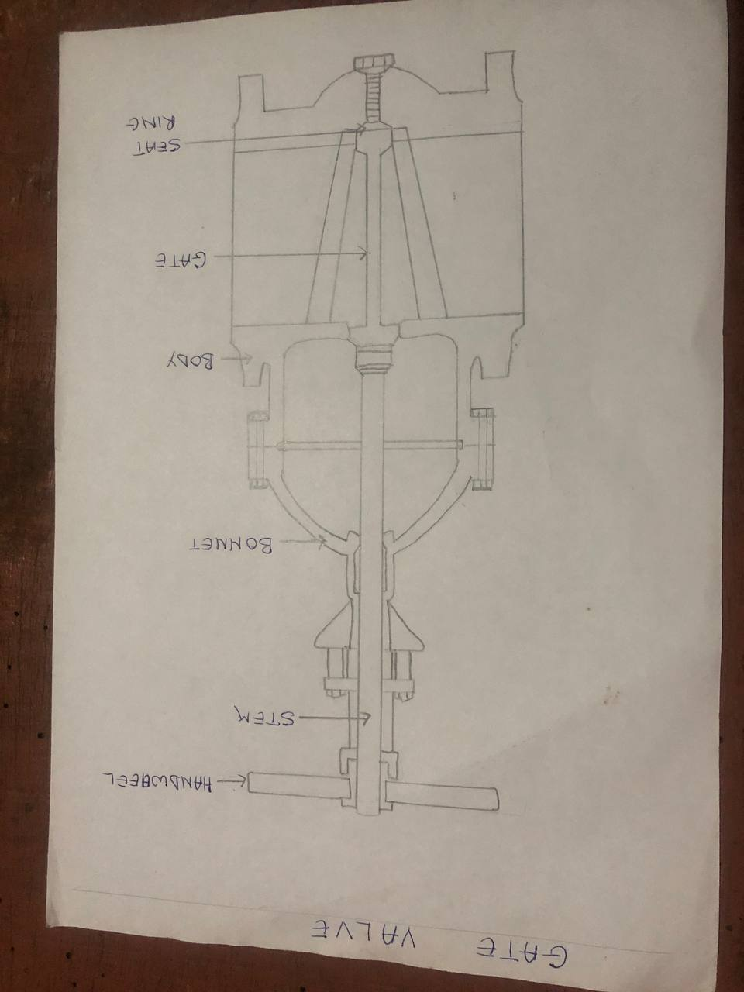
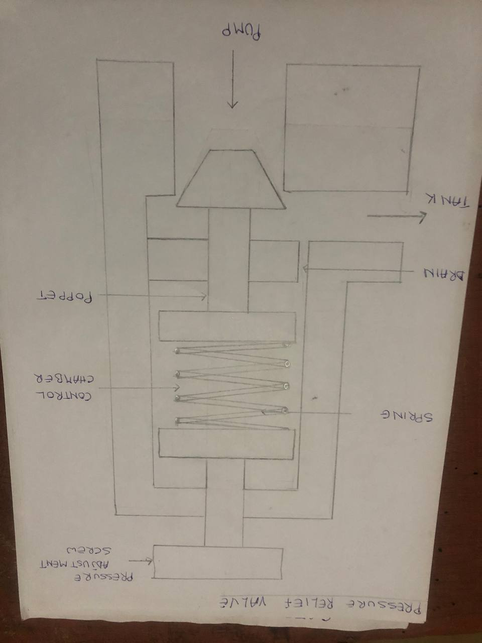
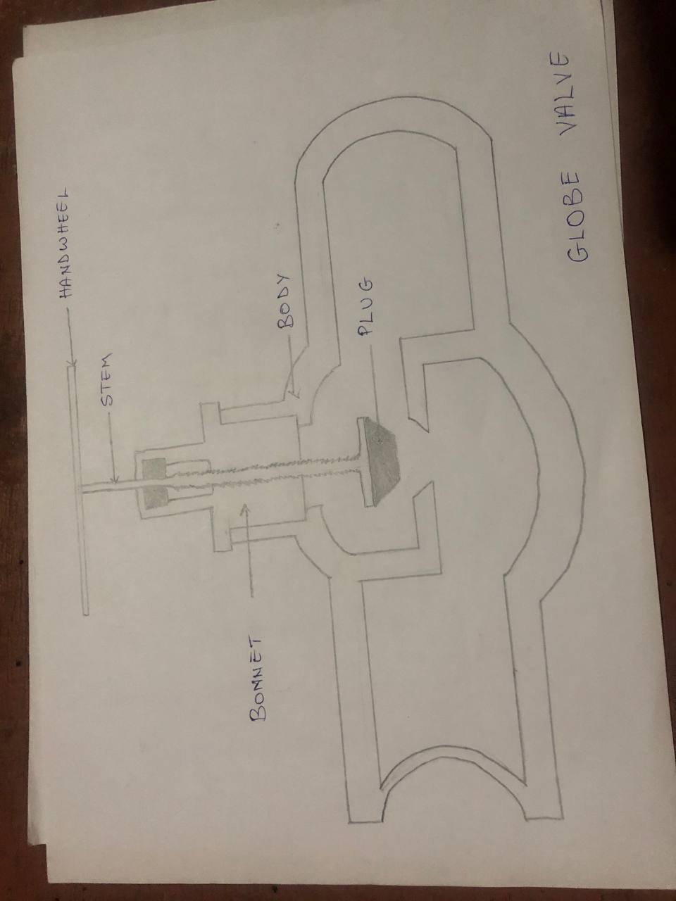
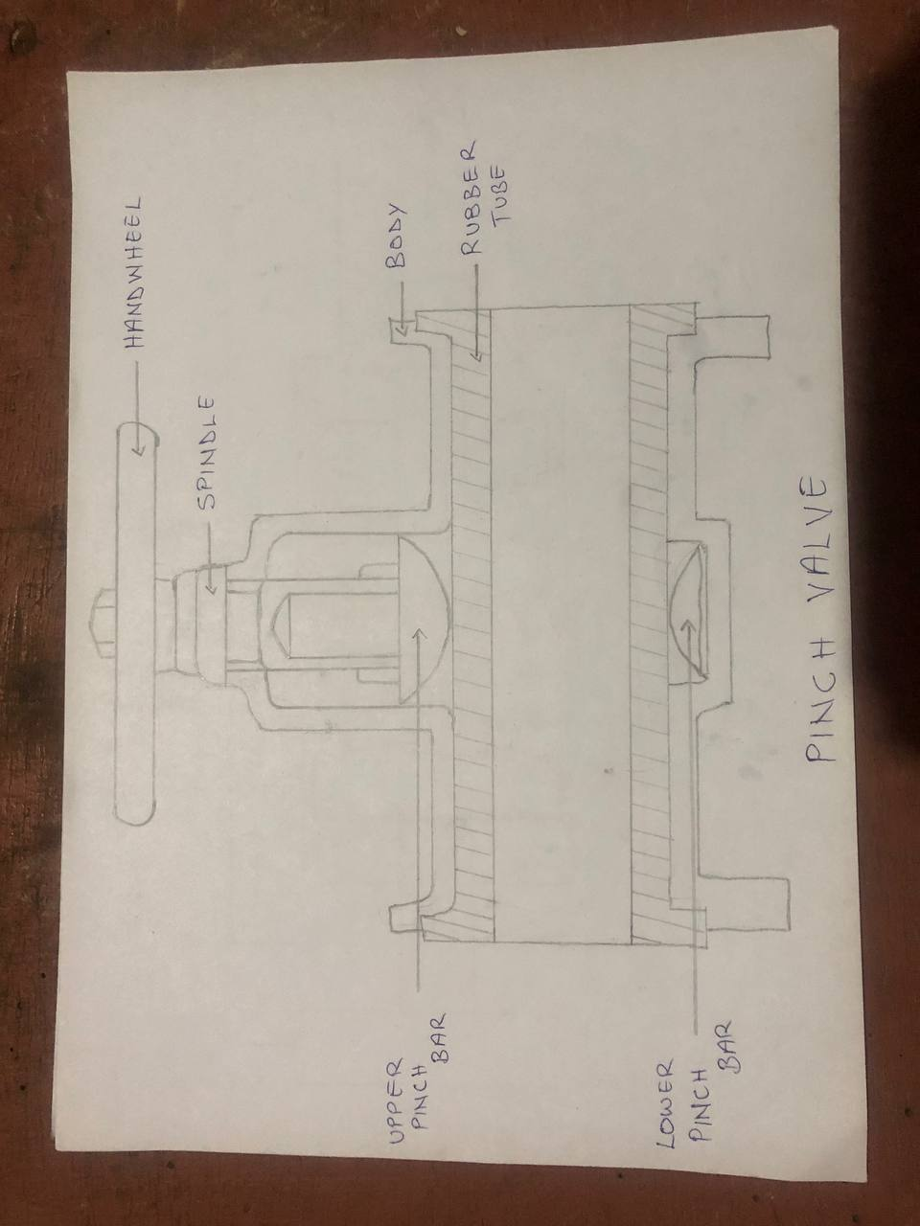
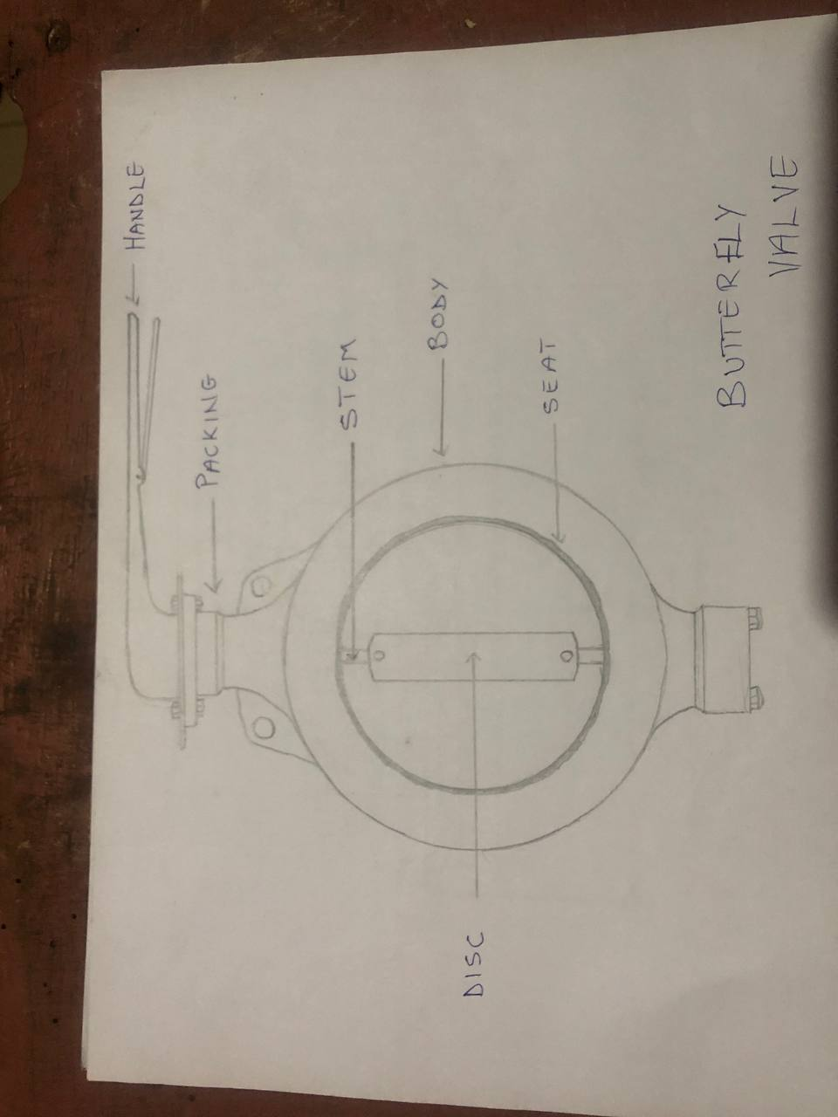
COMPONENTS OF VALVES
Valves are made up of several different components.
First is the valve body (shell), which holds all of the components together.
There is a bonnet, which covers the opening.
Valve trim refers to the internal parts.
Valve disks are designed to throttle or stop flow
Seal rings provide a seat for the disks
Valve stems help control the closing of the valve
MARINE GROUP ONE
AMOAKO BERNARD KOFI, ACHEAMPONG KOFI, ADDO D. GODFRED, LAMPTEY O. ISAIAH, BLANKSON ISAAC, EDEM KOMASHIE, JOSHUA AKUMANE
DR. MRS. EUNICE ADJEI (SUPERVISOR/ADVISOR)
VALVES
A valve is a device used for controlling the passage of fluid or air through a pipe or duct. Ships need valves to regulate the pressure and flow of fluids in the various onboard systems. Valves can effectively manage the transfer of liquids, steam, gases, and slurries.
Their general uses include;
Stop/start flow ,Reduce/increase flow, Control direction of flow ,Regulate flow or pressure, Relieve pressure from pipe systems
The following are the major types of valves used on marine vessels: Gate valves, Butterfly valves, Globe valves, Relief valves, Pinch valves, Piston valves, Ball valves, Diaphragm valves
It is designed to open at a predetermined pressure and relieve the pressure by allowing the pressurized fluid to exit from the system. The valve automatically closes once the system pressure reaches a safe level.
Uses of relief valves
The pressure relief valve is important in applications where pressure levels are crucial for fine operations such as steam, air, or gas power generation.
These valves are used to maintain sustained pressures downstream or upstream from the valve.
It consists of a spherical body divided into two halves by an internal baffle. The baffle diverts the flow of fluid, which ultimately drops the pressure. Furthermore, there is a stationary ring seat and movable disc which controls the fluid flow. This disc is lowered and raised by turning the handle. The flow rate is maximum when the disc is completely raised. On the other hand, the flow is shut off when the disc is lowered completely.
Uses of globe valves
Globe valve is used in applications where variable pressure is required in the pipeline such as emergency bilge suction line etc.
It can also be used as a non-return valve. This type of valves is used for preventing back flooding.
It is mostly used in applications where pressure drop is required.
It comes with a flexible tube that can be pinched mechanically to open and close the fluid path. It offers a straight flow path to fluids without any moving parts. Plus, there is a pinch mechanism to pinch the tube and create full closure of flow.
Uses of pinch valve
Pinch valve is ideal for granular products, slurries, and foodstuffs.
It is mostly used in places with low temperature due to the elastomeric tube.
When the valve is open, the disc becomes parallel to the direction of flow and allows the fluid to flow. While in the closed state, it is perpendicular to the pipe wall and blocks the flow.
Uses of butterfly valves
Butterfly valves are used where space is limited.
Butterfly valves can be used for throttling or regulating flow as well as in the full open and fully closed position.
The working of the gate valves is pretty simple as it does not involve any complex mechanism. The spindle wheel, which is attached to the spindle rod, is rotated to move the “gate” at right angle to the flow of the fluid. The screwed spindle works in a nut and lifts the valve to open or close the “gate” between the circular openings furnished with seats
Uses of gate valves
Gate valves are used in applications requiring minimum pressure loss.
They are also used in applications wherein bidirectional flow is required.

